Slide 1
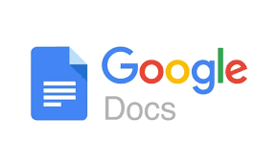
GOOGLE DOCS

Slide 2
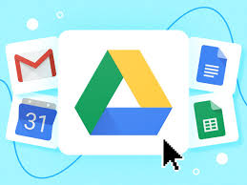
KEY FEATURES
Online Access & Cloud Storage
Google Docs is completely online, meaning you can access your documents from any device with an internet connection.
All documents are automatically saved in Google Drive, Google’s cloud storage service, preventing data loss.
You don’t have to manually save files—changes are saved in real time

Slide 3

Real-Time Collaboration
Multiple people can work on the same document at the same time.
Changes appear instantly, and users can see who is editing in real-time.
Users can leave comments and suggestions for better teamwork.

Slide 4
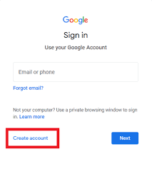
Free to Use
Google Docs is free for personal use.
It only requires a Google account to access.
Businesses can use it as part of Google Workspace (formerly G Suite), which includes additional features.

Slide 5
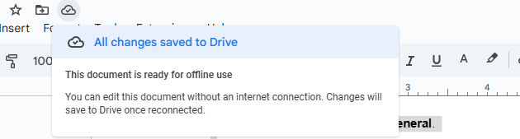
Auto-Save & Version History
Google Docs automatically saves all changes.
You can view and restore previous versions of a document using Version History.
This helps in tracking edits and recovering older content if needed.

Slide 6
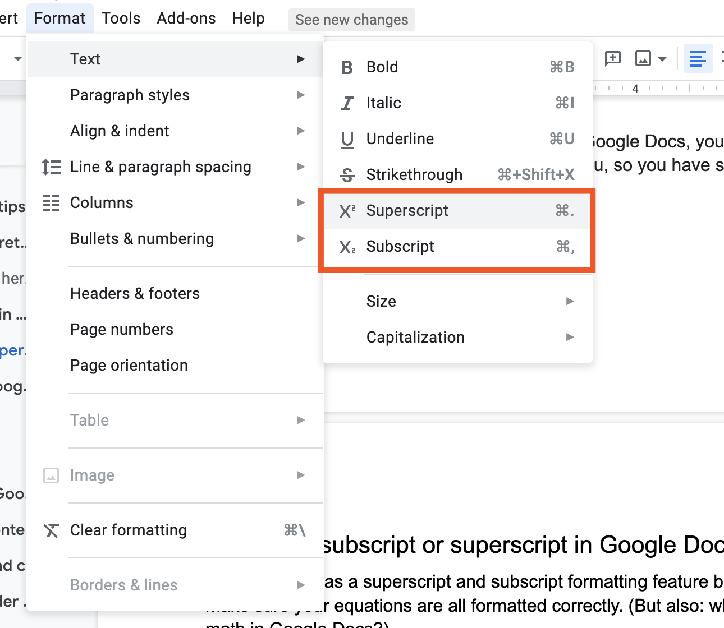
Easy Formatting & Editing
Google Docs provides tools for:
Changing fonts and colors
Adding images and tables
Inserting headers, footers, and page numbers
Using templates for resumes, reports, and letters

Slide 7
Offline Mode
You can enable offline mode to edit documents without an internet connection.
Changes will sync when you reconnect to the internet.
Integration with Other Google Apps
Google Docs connects easily with Google Sheets (spreadsheets), Google Slides (presentations), and Google Drive.
You can directly attach Google Docs to Gmail and share with others.

Slide 8
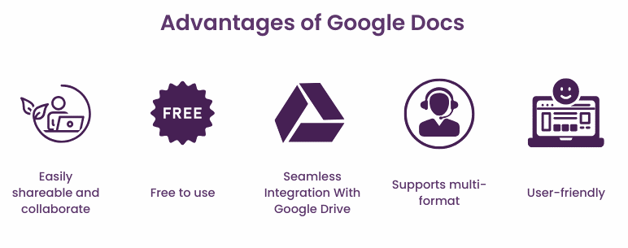
ADVANTAGES
Free and Easy to Use
No Installation Needed (Runs in a web browser)
Works on Any Device (PC, Mac, mobile, tablet)
Auto-Save Prevents Data Loss
Real-Time Collaboration & Sharing
Cloud Storage with Google Drive
Compatible with Microsoft Word Files

Slide 9
Step 1: Open Google Docs
On a Computer (PC/Laptop)
Open a web browser (Chrome, Firefox, Edge, etc.).
Go to docs.google.com.
Sign in with your Google account (Gmail).
On a Mobile Device (Phone/Tablet)
Download the Google Docs app from the Play Store (Android) or App Store (iPhone/iPad).
Open the app and sign in with your Google account.

Slide 10

Step 2: Create a New Document
On a Computer
Click the + Blank option to create a new document.
Or, select a Template (resume, report, letter, etc.).
On Mobile
Tap the + (plus sign) at the bottom-right corner.
Select New document or Choose template.

Slide 11
Step 3: Type and Edit Text
Click inside the document and start typing.
Use the toolbar at the top to format text:
Bold (B), Italic (I), Underline (U)
Change font size, color, or alignment
Insert bullet points or numbered lists

Slide 12
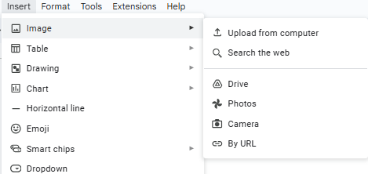
Step 4: Insert Images, Tables, and Links
Click Insert (on the toolbar) and choose:
Image (upload from your computer or Google Drive)
Table (select rows and columns)
Link (add hyperlinks)
Drawing (create simple shapes or diagrams)

Slide 13
Step 5: Save Your Work
Google Docs automatically saves your work in Google Drive.
You do not need to press "Save."

Slide 14
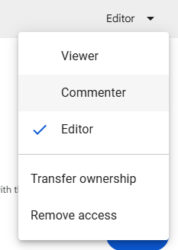
Step 6: Share & Collaborate
Click the Share button (top-right corner).
Enter an email address to send the document.
Set permissions:
Viewer – Can only read
Commenter – Can leave comments
Editor – Can make changes
💡 You can also create a shareable link to send via email, WhatsApp, or social media.

Slide 15
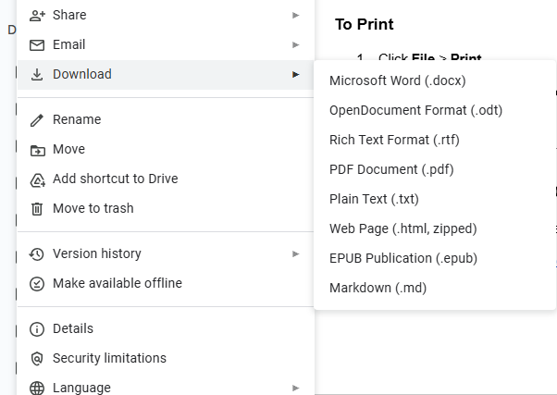
Step 7: Download & Print
To Download
Click File > Download.
Choose a format:
PDF (.pdf)
Microsoft Word (.docx)
Plain Text (.txt)
To Print
Click File > Print.
Select your printer and click Print.

Slide 16
Use Google Docs Offline
You can use Google Docs without the internet by enabling Offline Mode:
Open Google Drive (drive.google.com).
Click Settings (⚙️ gear icon) > General.
Turn on Offline Mode to edit without the internet.

